Slide 1
Path to Churn Modeling
Customer Retention
Chris Jackson, Terence Kong
November 22, 2018

Slide 2
Agenda
Customer Churn & Retention
Path to Churn Prediction
Schedule & Price

Slide 3
Customer Churn & Retention

Slide 4
Industry Perspective: How Sales, Servicing Affect Churn
Customer Opens Account
...The wrong type
Makes Cash Withdrawal
...Sees lower balance
Checks Account Online
...Sees fee
Customer Calls
• Requests fee refund
• Account Research
Sample Key Questions
• Where did breakdowns occur?
• To which customers?
• At what volumes?
• Where did successes happen?
Refund Approved
• Account corrected
• Opens credit card
Refund Denied
• Closes account
• Tells friends

Slide 5
Industry Perspective: How does this drive value? Engaged relationships improve retention and revenue
~9x
Investing & Planning
Revenue
Multiplier
~4x
Deposits & Borrowing
Retention: ~99%
Engaged Customer
Retention: ~99%
“…and I invest with you”
(e.g. investing)
Single Product
Retention: ~95%
“…and I also borrow
money from you”
(e.g. lending)
Retention: ~83%
“I bank
with you”
(e.g. primary account)
“I have an account
with you”
(e.g. checking)
Typical Primary Checking
• Recurring Deposit
• Active Debit Use
• Active OLB/Bill Pay

Slide 6
Business Value Drivers – Churn Analytics Capabilities
Advanced Analytics Create Value Directly & Indirectly
Direct Benefits, e.g.,
ID relationships at risk of attrition --“Rescue” opportunities early enough to take action
ID root causes of attrition
ID process improvements to improve customer engagement (and retention and cross-sell as a result)
Indirect Benefits, e.g.,
Reduce root causes of unnecessary op expenses, e.g., customer calls
Improve take rate of self-service – e.g., direct deposit, mobile – reducing more expensive agent-assisted transactions
Notes:
Advanced Analytics drive two areas of potential benefit: Direct & Indirect
Direct Benefits = revenue retained when Analytics uncovers relationships at risk and root causes of attrition, PLUS potential revenue of future cross-sell of saved relationships
Indirect: Op costs avoided by correcting root causes – e.g., ID process that led to improper fee, so no fee charged, so customer doesn’t call to ask about it, doesn’t come to branch and take time to close account.

Slide 7
Direct Benefits of Churn Analytic Capabilities
Create value directly through improving customer relationships
Direct Revenue Benefit
$40 - $120 per checking customer
Rescue 5,000 customers = $200K - $600K/year
$4MM - $12MM at scale:100K retention win
Rescue: Offers to win-over customers at risk
Process Improvement: Assess sales, service and onboarding processes to enhance engagement and retention :
From: 1 in 6 unengaged customers close accounts per year
To: Only 1 in 20 engaged customers close per year (e.g., direct deposit, active debit, bill pay)
Also: Prevent closures caused by poor product fit in channels
Cross-sell improves: more “touches” in online channels; higher quality engagements in assisted channels
Benefits of cross-sell:
Retention improves – upward of 95%
Revenue improves
3X to 5X for lending customers
5X to 10X for checking with brokerage & investing
Cross-Sell Revenue Benefit
$80 - $600/year for lending per customer
$200 - $1100 /year for investing per customer
$1.2MM - $12MM (increase of 10K in cross-sale)
Notes:
Examples of direct benefits – these are industry ranges based on consumer checking. Typically, banks lose about one in six new DDAs. That’s about 15-20%. Many of those leave because they never really got going with their new account, e.g., direct deposit etc.
If a bank succeeds in engaging new checking customer to have them bring over their paycheck, to pay bills, use the primary features of a new account, that retention rate jumps to 95%.
The more customers retained, the more direct revenue, and the more potential to deepen those relationships with other, more profitable services such as credit….

Slide 8
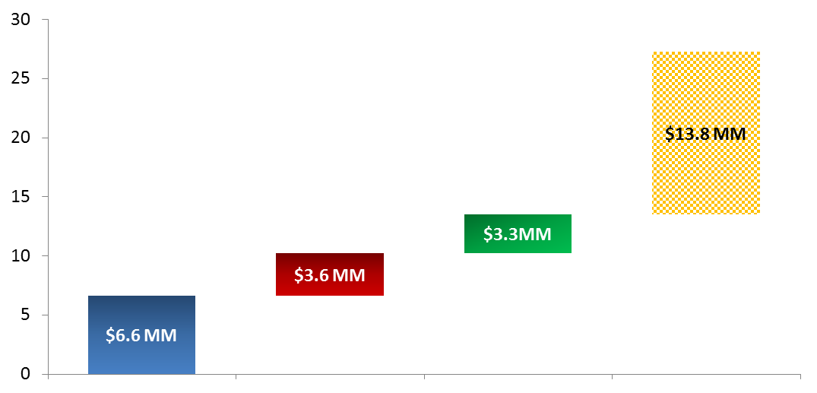
Business Value for Customer Attrition: Sample scenario using industry average numbers
$13MM - $27MM
3 Year Business Impact =
$ Impact over 3 Years (in Millions)
Customer Replacement Costs Avoided
Cross-Sell Opportunity
Higher retention rate due to reduced latency between detection and reaction - 21% vs. 20% prior
Unengaged, At-Risk customers detected with Aster
Higher Detection Rate at 55% vs. 50% prior
Assumptions
Annual New DDA Customers – 1MM
Average Revenue per New Customer per year - $80
Cost of Customer Acquisition - $250
Cross-Sell: 10% X-Sold, 5X Revenue Lift
% of Customers At Risk of leaving - 17%
At Risk Customer Detection Rate – 50%
Retention Rate – 20%
Net Attrition Rate – 15%
Notes:
Here’s a sample estimate for business value for a large Bank that leverages advanced analytics to improve engagement of new customers as we discussed
The key driver in blue = direct benefit of relationships saved via greater engagement. Note that this lift seems small:
Take that 17% year one attrition rate
A good bank already has methods in place to detects opportunities to better engage with DD, debit, OLB, etc –say 50% of opportunities detected, like a customer who SHOULD have the ability to start Direct deposit but hasn’t yet, or process improvements like better training for sales, better collateral in channels, better process for debit activation etc….
Based on prior work, we’d estimate that more advanced analytics drive only an incremental 5 points of detection – taking 50% to 55%
…and of the detection opportunities, we’d see only about a 20% retention rate – this acknowledges that most customers (80%) who don’t engage, or who decide they really don’t want that new account after all…they actually have rational reasons for their inaction or decision and we can’t change that, no matter how good our analytics are.
Put another way, you take year one attrition from 17% to 15% Sounds small, but the illustration shows how that adds up quickly for a large institution = ~$7mm

Slide 9
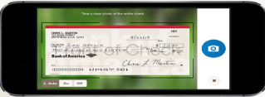

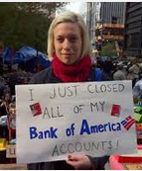

Rescue Offer Scenario: Product Miss-Fit
Analytics Opportunities:
Customers at risk
Root cause ID
Sales & Service
Product design
Journey Metrics
Self Service Attempts
Researches account online
Sees fee
% 1st Call Resolution
At ATM, customer
Customer calls
Requests fee refund
sees lower balance
$12 Monthly Service Fee
60 day trial ends…
Journey Metrics:
By Branch
By Call Center
By Seller/agent
By Product,
By marketing asset/promotion,
…Balance < minimum
…Monthly fee assessed
Request denied
Closes account
Tells friends
%, # New Customer Fees
Opens account…
…the wrong type
#, % New Product Changes
Teradata Confidential
Notes:
Here’s a sadly typical churn scenario that becomes an opportunity much faster when advanced analytics make assessing a multi-step journey more efficient.
New checking account was sold the wrong product – or perhaps wasn’t effectively presented with the value of the relationship
The account is charged the right fee for the account opened, but it wasn’t something the customer expected, or wasn’t something they felt was fair
The customer notices this when she sees a lower balance on the ATM receipt, and because it wasn’t expected, she’s confused and upset
She does try to self service using OLB…but it doesn’t address the core question so she calls
..And the agent, probably using a fee waiver decision tool, follows the guidelines and refuses the refund….so the customer quits, and lets every one know about it
Advanced analytics quickly makes metrics become available, not in aggregate, which hides differences in high volumes, but in sequence – e.g., by “stop” on the customer journey…which reveals differences that now become opportunities.
Advanced analytics demystify the journey – and a bank could figure out root causes – for example, if a group of branches generate scenarios like this, that’s an opportunity to prevent root cause…if a call center team generates a significant volume of these, that’s an opportunity to improve rescue execution

Slide 10
Rescue Offer Scenario: Journey Assessment
Improved cross-sell
Rescue offers:
Product Change
Set up Direct Deposit
Extend Grace period
Opens credit card
Benefits:
$40 - $120 per checking customer
$80 - $600/year for lending
Notify and Extend Grace period
$12 Monthly Service Fee
Root Cause Opportunities:
Where did breakdowns occur?
What branches miss-fit?
What products?
At what volumes?
Where did successes happen?
Detection Opportunities:
Balance Too Low
No Direct Deposit
Opens account
Teradata Confidential
Notes:
Here’s what we mean by a rescue scenario
Analytics that mature to the point they become operational enable not just training, process, and policy improvements, they also enable rescue.
Once trends are alive in the operational model, the system can detect when a customer behaves in a way that is inconsistent with the model, making possible triage ranging from preventative measures to proactive messages.
In this case, when a customer who meets the profile of someone who would typically have a balance well above minimums, or who should have the ability to set up direct deposit, rather than just charging the fee and putting the customer and a front line agent in the position of reacting to a negative situation, the bank suspends the fee and enables the parties to find a proactive solution from a situation where messaging has established trust rather than distrust.

Slide 11
Path to Churn Prediction

Slide 12
Events
An event is anything that happens or takes place at a determinable time and location. In customer journey analysis, we analyze events which are related to customer.
In banking, events can be classified into 2 types:
Non-monetary events, such as account opening, balance check, and customer service visit.
Monetary events, such as cash withdrawal, funds transfer, and cash deposit.
Some events are specific to a channel and others may need to be mapped into a common omni-channel taxonomy for consolidation.
Withdraw funds is available via ATM and Branch but not Mobile; if the identifiers for the event are different, they have to first be consolidated to a more general classification.
Goal is to reduce thousands of discrete events to smaller group of typically 30-100 common, channel-independent events.
Event #1
#5
#7
Time Gap
#8
#3
#10
#4
#9
#11
#2
#6
Customer

Slide 13
Event Derivation
List of samples only – not-exhaustive
Financial Transactions
Non-Financial Transactions
Other Records
Credit card, Loan, Mortgage Fees
Bill Payments
Fund transfers
Deposits
Penalties
Credit scoring & Limits changes
Collections activity
CRM activity
Fraud indicators
Marketing campaigns & responses
Logs & clickstream activity
Account Open Date
Account Close Date
Blacklist Date
Address Change
Authorized Party Change
Notification of Death
Transactions
Transactions
Record
Transactions
Transactions
Financial Transactions
Non-Financial Transactions
Monetary Events
Non-Monetary Events
Implied Event
Consolidated Omni-Channel Event
Consolidated Omni-Channel Event
Channel Event
Event

Slide 14
Complex Events and Account Qualification
Some key events require timeseries analysis such as:
Account becomes dormant or resume activity after a period of dormancy
Equivalent states may need to be mapped for consolidation
A dormant account with a low balance can be treated as a churn event just like a closed account
Accounts may require a minimum duration or amount of activity to qualify for analysis
Exclude accounts without customer initiated activity within a time window
Exclude accounts where the reason the account was closed is not churn related such as death of the customer
Exclude accounts that have been open less than N Days
Exclude accounts with less than a minimum number of events (e.g. about 30)

Slide 15
Build an Event Registry
Customer Profile
Campaign Events & Responses
Already Existing
Event
Registry
Needed for Segmentation and Hidden SME Use Cases
Monetary Events
Campaigns
Sessionization
Non-Monetary Events
Needed for Churn and Retention Use Cases
Customer Enrichment
(Churn Score, Segment, Cluster, etc.)
Drive new types of campaigns and centralize Customer data in Teradata
Other Events

Slide 16
Sessions
A session is a set of events that are separated by at most n numbers of time unit.
Event #1
Session 1
Session 2
#5
#7
Time Gap
#8
#3
#10
#4
#9
#11
#2
#6
Customer
For customer churn/retention analysis, we typically use longer sessions such as a week, because the events that lead up to a decision to close a bank account usually occur across multiple days and channels.

Slide 17
Path to Churn using Markov Chain
Online Banking Clickstream session - Account closure (Churn/No-Churn)
Customer A
Customer B
Customer A goes through a series of events and does not end the session with account closure. On the contrary, customer B indicates events that end up in account closure.
We can use Markov Chain to analyze pattern in their behavior and predict the odd of someone new end up in account closure based on his/her behavior pattern.
Interaction events
View Account Summary
Money Transfer
Pay Bill
Pay Bill
View Account summary
Transfer to Savings
Pay Credit card
Transfer to External
Contact Support
View products & offers
View products & offers
Logout
Events that lead to Account Closure
View Account Summary
Money Transfer
Money Transfer
Fee Reversal Request
View Products Rates & Offers
View Account Summary
Fee Reversal Request
View Products Rates & Offers
Acct Closed
Billions of sessions and 1000s of events in your event stream but typically less than 5% lead to interesting outcomes (SIGNAL)
✓
X

Slide 18
Markov Chain Methodology – Step 1
Step 1: sessionization
We explore all possible data sources to build trains of events happened to our customers sorting them into sequential order. We then separate each train into sessions based on time gaps. After that, we indicate sessions which end with the event of interest and which sessions did not.
View Account Summary
View Deposit Details
FAQ
Account History
Account History
View Account Summary
Uneventful session
Account History
Raise Complaint Ticket
Fund Transfer
Fund Transfer
Call Customer Service
Account Closure
Eventful session
The transition between a smaller number of sequential events is more statistically significant for prediction than a long sequence of events that leads to an outcome
Event of interest

Slide 19
Markov Chain – Event Transitions
If you look at all pairs of events next to each other across millions of events
There are a set of pairs that are more likely to occur in sessions with interesting outcomes than the sessions without an interesting outcome
The simplicity of Markov process starts with 2 event transitions
Can easily extend to 3, 4 or 5 events that occur together
Also called as 2nd, 3rd, 4th etc., ORDER MARKOV CHAINS
B.C
C.D
1st Order
A.B
C.C
D.E
Account History
Raise Complaint Ticket
Fund Transfer
Fund Transfer
Call Customer Service
Account Closure
Session
A
B
C
C
E
D
A.B.C
C.D.E
2nd Order
B.C.C
C.C.D

Slide 20
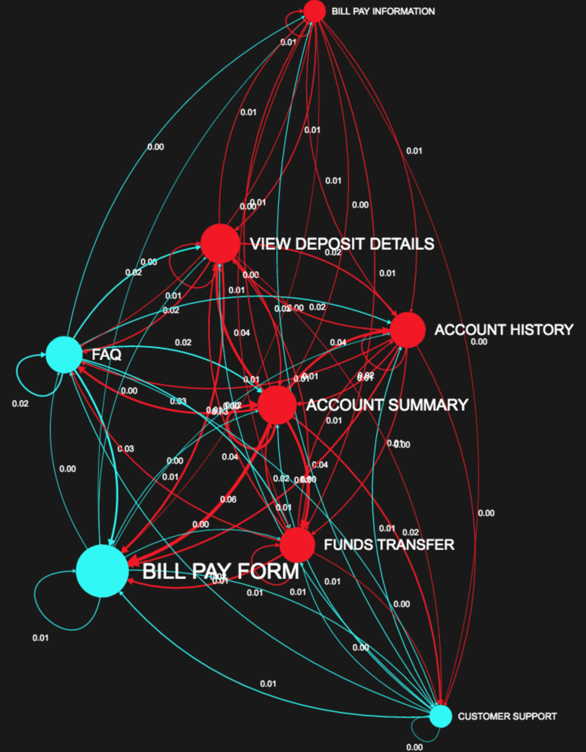
Markov Chain Methodology – Step 2
Step 2: Build transition matrices
Transition matrix indicates the probability of occurrence of two adjacent events. For our analysis, we need to build two transition matrices, for eventful session and for uneventful session.
 | AH | AS | BPF | BPI | CS | FAQ | FT | OSE | PU | VDD
AH | 0.012 | 0.016 | 0.02 | 0.007 | 0.005 | 0.014 | 0.011 | 0.008 | 0.001 | 0.016
AS | 0.036 | 0.038 | 0.057 | 0.010 | 0.020 | 0.030 | 0.038 | 0.008 | 0.016 | 0.040
BPF | 0.001 | 0.004 | 0.007 | 0.000 | 0.007 | 0.002 | 0.004 | 0.002 | 0.000 | 0.002
BPI | 0.006 | 0.005 | 0.000 | 0.012 | 0.001 | 0.005 | 0.008 | 0.004 | 0.001 | 0.012
CS | 0.007 | 0.007 | 0.012 | 0.006 | 0.000 | 0.007 | 0.004 | 0.007 | 0.002 | 0.006
FAQ | 0.011 | 0.018 | 0.028 | 0.005 | 0.005 | 0.018 | 0.013 | 0.004 | 0.002 | 0.018
FT | 0.011 | 0.016 | 0.024 | 0.005 | 0.005 | 0.014 | 0.013 | 0.006 | 0.010 | 0.016
OSE | 0.006 | 0.010 | 0.007 | 0.004 | 0.004 | 0.010 | 0.004 | 0.000 | 0.002 | 0.005
PU | 0.007 | 0.001 | 0.006 | 0.000 | 0.006 | 0.002 | 0.007 | 0.002 | 0.000 | 0.006
VDD | 0.018 | 0.016 | 0.029 | 0.007 | 0.004 | 0.017 | 0.012 | 0.007 | 0.005 | 0.012
Network of events
Transition matrix

Slide 21
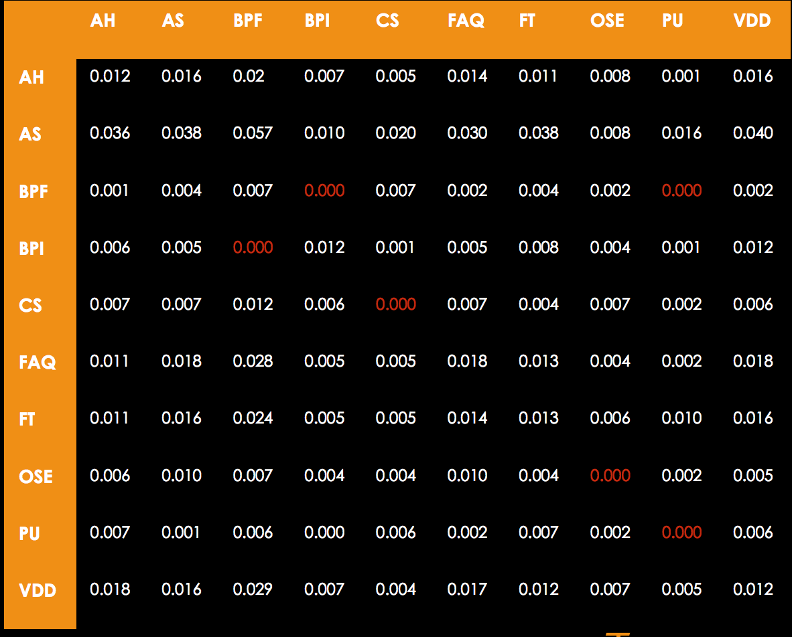
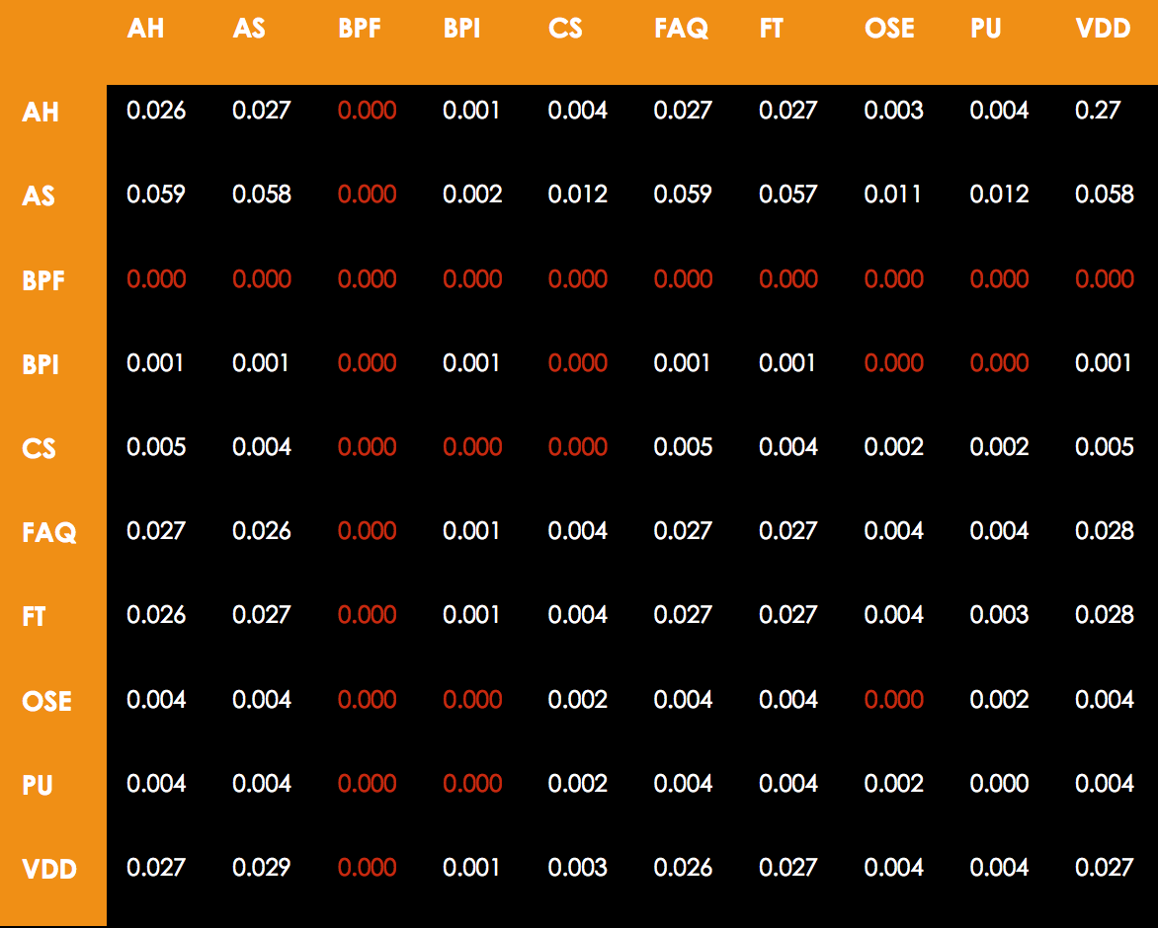

Markov Chain Methodology – Step 3
Step 3: Score the behavior of customers
Calculate the sum of log odds ratio for customers to know the likelihood of them closing their account.
View Account Summary
View Deposit Details
FAQ
Account History
Fund Transfer
View Account Summary
-1.35
Log Odds Ratio = SUM(LOG(P[X_{i}|X_{i-1}] for BPF) – SUM(LOG(P[X_{i}|X_{i-1}] for NOT BPF)
i > 1
Account Closure
???
View Account Summary
Fund Transfer
FAQ
View Deposit Details
Bill Pay Form
Account History
4.80
More likely to churn
Use all available data for selected customers to train while reserving a subset of customers for validation
Sampling should be for customers only, not a subset of events
Consolidation to a low cardinality set of events (30-100) and sessionization with the right time window can be iteratively tuned

Slide 22
Distribution of log odds ratio
Tips to reduce false positives & negatives
Instead of building Markov transitions for all customers, try building on known customer segments
Ignore short sessions and other outliers because short sessions create a lot of noise and are really not useful for training. Pick sessions with at-least X # of events or at-most Y# of events
Try 3rd or 4th order Transition matrix changing pattern from A.B to A.B.C or A.B.C.D
Retention
# of sessions
Churn
confusion
log_odds_ratio
TRUE NEGATIVES
TRUE POSITIVES (SIGNAL)
FALSE NEGATIVES &
POSITIVES

Slide 23
Considerations for Implementation
Building a transition matrix with millions of rows & events requires significant processing capability for grouping and summarization
Compute time increases dramatically as MARKOV ORDER goes up.
Modeling and scoring using NPATH is done in a single pass across data
Data prep using sessionization is key to get useful transition matrices. Sessionization is hard or even impossible without specialized libraries.
Suggested Target an 85-90% Accuracy
Note: no guarantee that target accuracy can be achieved in the available time; additional iterations or model refinement will require a contract change request and incur additional costs.

Slide 24

Data Preparation using Teradata
Access Options in Order of Preference
Assess data in Teradata EDW
Assess other data in Oracle EDW
Request file from existing Data Marts
Request file from source system owner
Preprocessed data transfer to Teradata for analytic
Oracle
Teradata
EDW
EDW
1
Data
2
Customers
4
View
Query & Result Set
Model Output
S
3
Sessionize
SQL (in Database)
Sources
DM Funding
Data Feed
5
Hadoop
nPath
Staging
Data Preprocessing
Visualize in SanKey
3
DM
Credit Card
PAGAI
Derived & Enriched Data
3
Customer Profile
Account History
DM
Loans
Event History
Transaction History

Slide 25
Data Touched Customer Path to Churn
Assumes data from Hidden Businessman Use Case is available
Customer Data: Demographic/ Profile/ Product Holding
Transactions data – All products – Card, Mortgage, CASA, UPL, OD
Customers who closed Credit Card in last 12 months and all data for 12 months PRIOR to closure
Collections data – Cards, Mortgage, UPL
Collections default indicators – e.g. area, segment, income, race, profession etc.
LOS data (Loan Origination System) data
Channel behavior data – ATM, Branch, M2U, Call Centre, Email
Complaint Management System (CMS) data

Slide 26
Schedule & Price

Slide 27

Proposed Plan
Activities
W1
W2
W3
W4
W5
W6
W7
W8
W9
Planning & Prepare
Iteration
Discover & Explore
1
Iteration
Build Model
Execute & Validate
2
Teradata man-days estimation
Project Manager | 12d
Industry Consultant | 19d
Data Scientist/Analytic Team Lead | 48d
Data Engineer | 37d
BCA man-days estimation
Project Manager | 15d
SME | 20d
Analyst | 35d
Source Data Expert(s) | 25d
#
Milestone

Slide 28
Proposed Price
Assumptions
Contract signed in December 2018
Project start date in Q1 2019
Data and environment from Hidden Businessman Use Case available
PRICE INTENTIONALLY REMOVED
Price valid for 14 days after presentation
Notes:
Insert Chart or list of key milestones or high-level GANTT chart(s) which shows:
a) Phases / Delivery milestones,
b) Critical path activities,
c) Billing and revenue recognition milestones.
Can be taken from MS Project or similar tool.

Slide 29
Timebox and Results
Analytics projects require exploration and discovery and no specific outcomes or insights can be promised or guaranteed
Customers must assign dedicated participants to the team, make data and/or system access available to team members before the project starts, and provide resources for the project team to be co-located onsite
Management Team must provide the project team a path to approve requests, expedite actions, and remove identified roadblocks
Teradata will work in good faith to rapidly and efficiently work with BCA using an iterative approach and flexible discovery process
All activities in the schedule are time-boxed to a maximum duration

Slide 31
Teradata Path Analysis Guided Analytics Interface
PAGAI

Slide 32
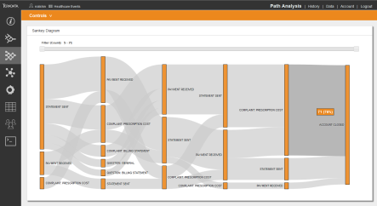
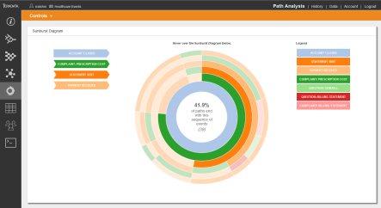
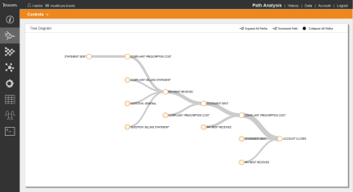
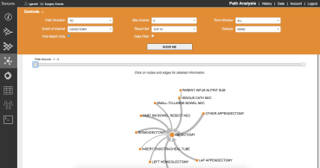
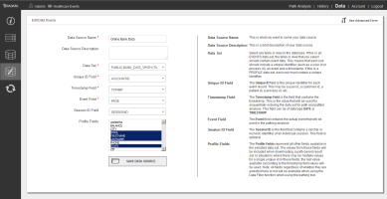
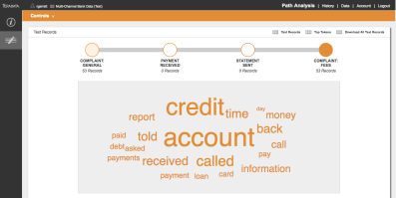
Path Analysis Guided Analytics Interface
The Leader In Multi-channel Path Analysis For The Business
Incorporate data from all channels and sources
So you can visualize what’s happening
And identify to whom it’s happening
All in minutes!
Notes:
Visualize what’s happening
Compare paths
And the customers on those paths
Score paths with factors such as marketing or support costs
Investigate text associated with events of interest
Export path-based customer lists for operational follow-up

Slide 33
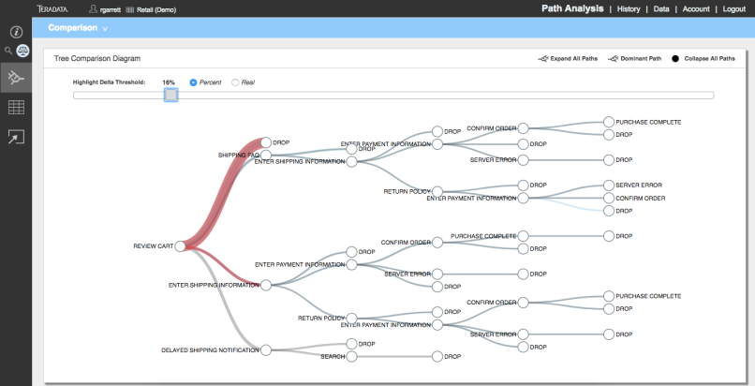
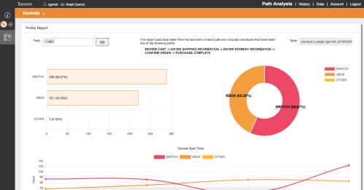
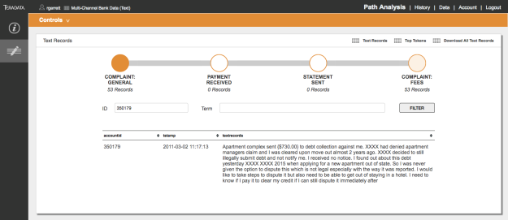
Path Analysis Guided Analytics Interface
Overview: Key Features
Visually, interactively build & explore journeys.
Visualizations include Tree, Sankey, Sigma, Sunburst, and bar charts.
Compare paths and the customers on those paths
Score paths
Investigate text associated with events of interest
Identify and export lists of individual customers on specific paths.
Notes:
Visualize what’s happening
Compare paths
And the customers on those paths
Score paths with factors such as marketing or support costs
Investigate text associated with events of interest
Dig deep into text-based events. Drill into key accounts or terms
Export path-based customer lists for operational follow-up

Slide 34
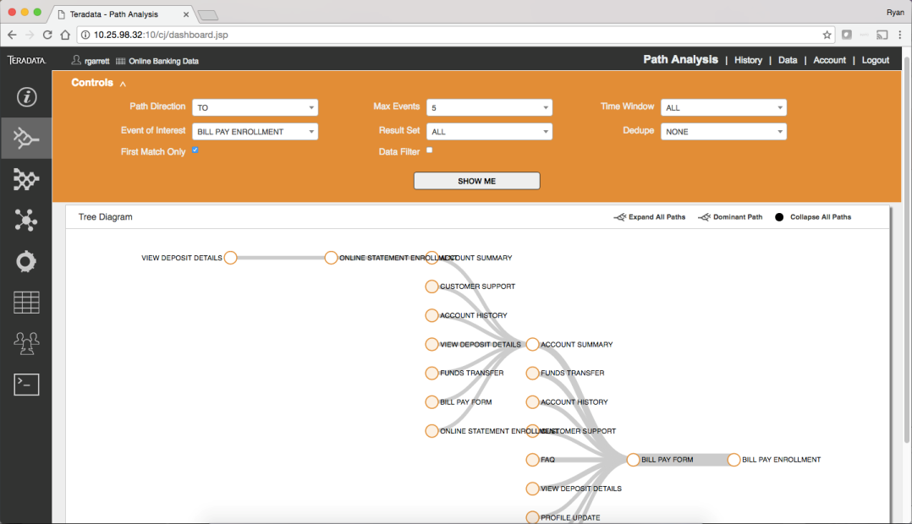
Visually, Interactively Build & Explore Paths
Business-ready Guided Analytics Interface
Built for the business user
No coding – or expert skills – required

Slide 35
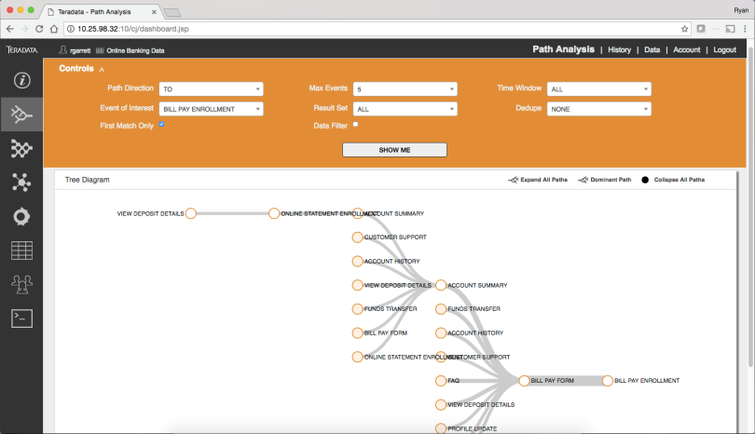
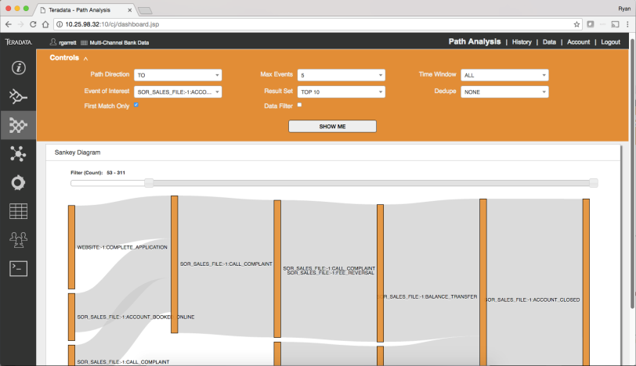
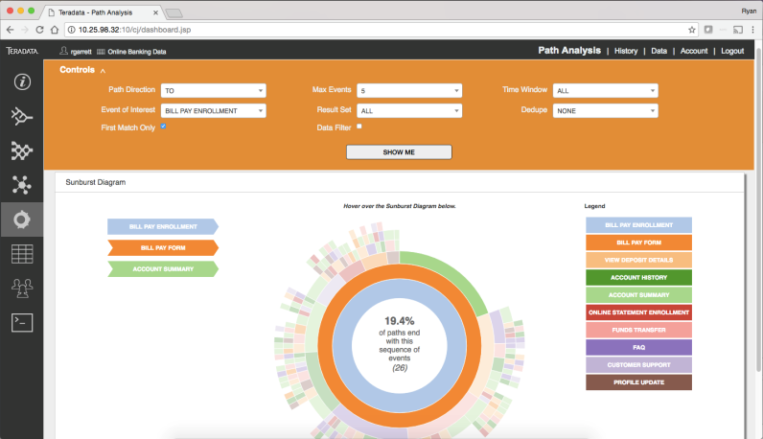
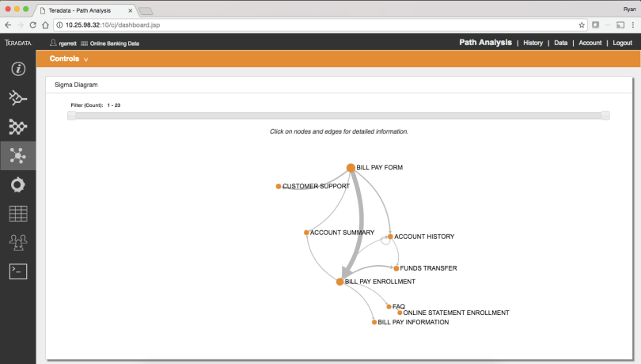
Interact With Advanced Path Visualizations
Tree, Sankey, Sigma & Sunburst Diagrams

Slide 36
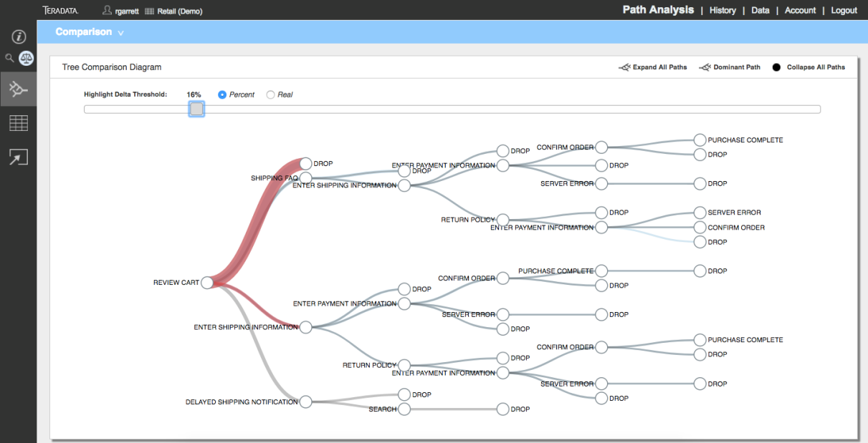

Interact With Advanced Path Visualizations
Compare Paths And Customers On Those Paths

Slide 37
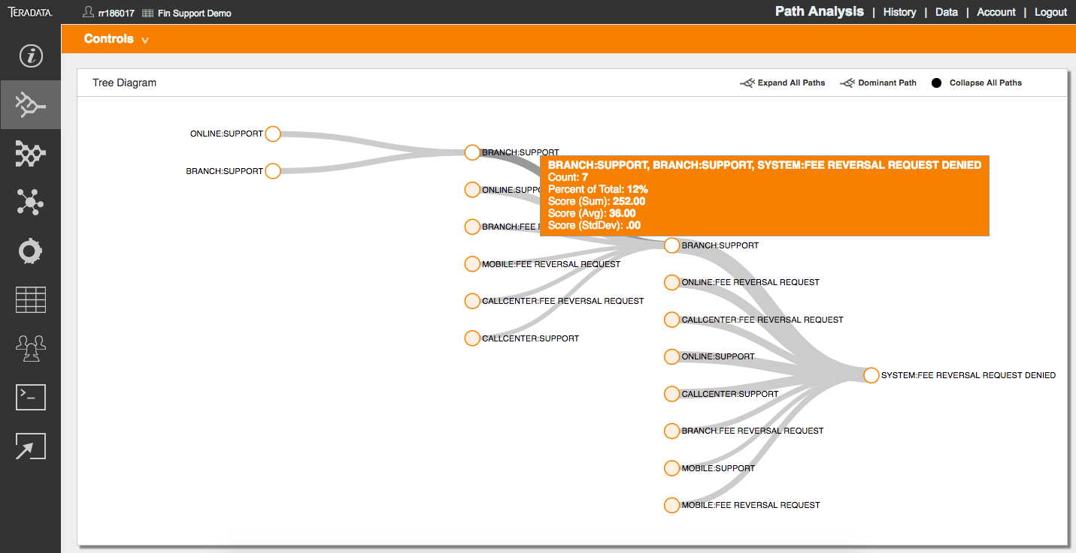
Score The Costs Of Paths
Incorporate Marketing Costs Or Support Costs Into Path Analysis

Slide 38
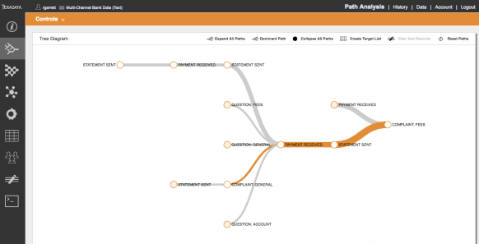

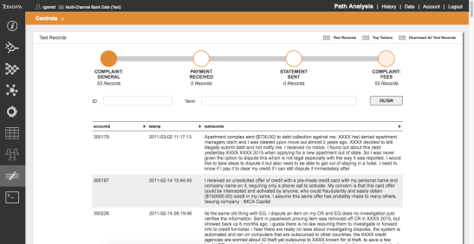
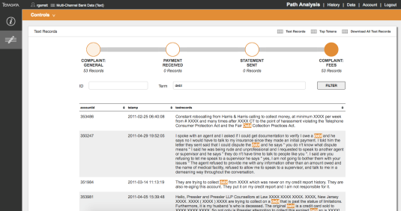
Dig Deep Into Text-Based Events
Drill Into Key Customers or Terms
Highlight a path
View text records
Drill into terms or accounts

Slide 39
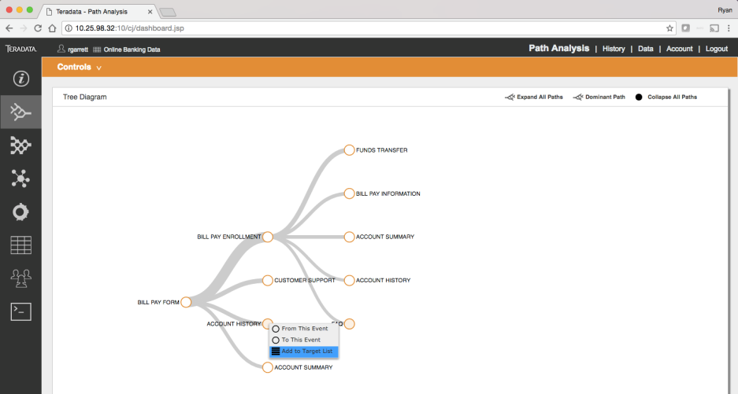
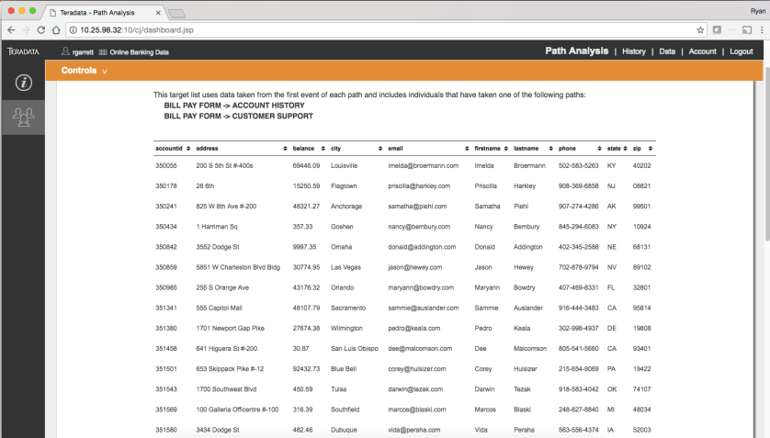

Identify Individual Customers on Specific Paths
Build Lists For Operational Follow-up
Click on a path.
Download a list of all customers on that path.
Notes:
Complete paths or partial paths

